Slide 1
Combination of Patterns
(Interpreter + Prototype)
- Ankur Pandey
Notes:
title slide

Slide 2
Agenda
Flashback - Interpreter Pattern
Flashback - Prototype Pattern
Package Builder Wizard Introduction
Package Builder Wizard Implementation

Slide 3
Flashback - Interpreter Pattern Introduction
Given a language ,define a representation of its grammar along with an interpreter that uses the representation to interpret sentences in the language. eg. string matching
The interpreter pattern is a design pattern that specifies how to evaluate sentences in a language.
This pattern involves implementing an expression interface which tells to interpret a particular context.
Grammar is represented by an Abstract Syntax tree.

Slide 4
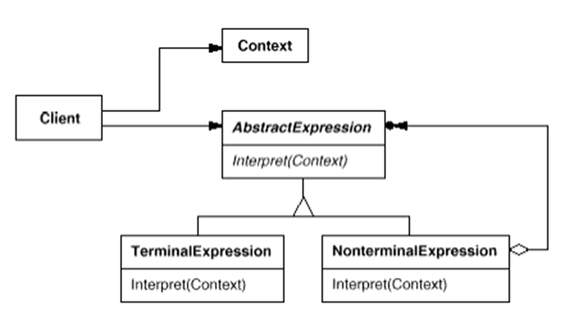
Flashback - Interpreter Pattern Structure

Slide 5
Flashback - Interpreter Pattern Collaborations
Client builds the sentence and invokes the Interpret operation.
Context contains the information that is used by the interpreter.
Each Nonterminal-Expression node defines Interpreter on Sub expression in a recursive manner.
Ex: a = b + c
b = d + 5, c = 2, d= 4
The Interpret operations at each non-terminal node use the context to store and access the state of the interpreter.

Slide 6
Flashback - Interpreter Pattern Benefits
It's easy to change and extend the grammar
Implementing the grammar is easy,
Adding new ways to interpret expressions

Slide 7
Flashback - Prototype Pattern Introduction
“Specify the kinds of objects to create using a prototypical instance and create new objects by copying this prototype”

Slide 8
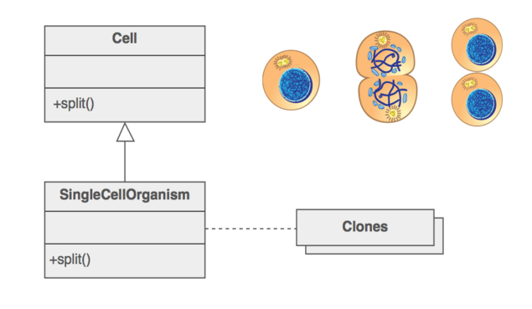
Flashback - Prototype Pattern Example

Slide 9
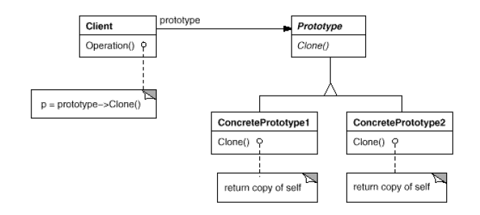
Flashback - Prototype Pattern Structure

Slide 10
Flashback - Prototype Pattern Participants
Prototype
Declares an instance for cloning itself
Concrete Prototype
Implement an operation of cloning itself
Client
Creates the object by asking the prototype to clone itself

Slide 11
Flashback - Prototype Pattern Benefits
If the cost of creating the object is expensive or complicated
When the client application needs to be unaware of the object creation, composition and representation
Objects are required which are similar to the existing objects

Slide 12
Package Builder Wizard Introduction
Example of a wizard we use.
Role of Interpreter and Prototype Patterns.
What we wanted to achieve using the above patterns.

Slide 13
Package Builder Wizard Rules
Package : Manual & Maintenance & Namespace
Manual : Prolog & Package Operations
Maintenance : Req.Files & BuildProcess & VersionHistory
Namespace : Class* || struct*
Class : Class* || TestStub

Slide 14
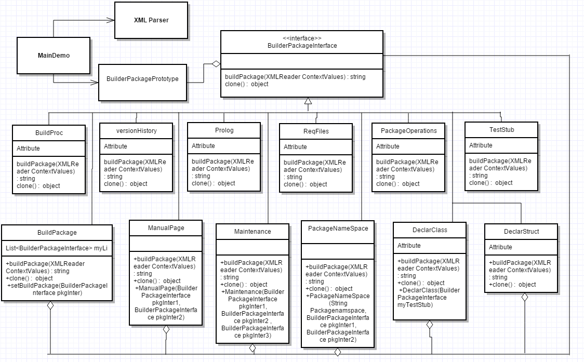
Package Builder Wizard Class Diagram

Slide 15
Implementation
Code Demo
Notes:
BuildPackage : our prototype class which store context in Dictionary
While Building Passing bool value to give user want a new build or use previously created one
AddExpression , OrExpression , Manual ,Maintaince , declare , defne class are non terminal class
Prolog , PackageOperations , Req files, Build Proc , Version History , classDeclare , Struct Declare , DataDef , Method Def, TestStub are terminal class
Use list<BuildpackageInterace> to addDifferent type of context Expression AddExpression , OrExpression class
Use writeTofile function of BuildPackage to generate required text file
Used Xml Parsing to parse User configured data

Slide 16
Questions?

Slide 17
Thank You!!

